Slide 1




The course notes are partly based on the Machine learning course presented by Andrew Ng at Stanford University and the original can be found at https://www.coursera.org/course/ml b
e.
All materials without annotations or marks are copyrighted by their copyright owner.
All the codes and modified slides are available at Github & OSChina
The project homepage:
https://github.com/sunzuolei/ml
https://git.oschina.net/samuel/ml
The Git repository:
https://github.com/sunzuolei/ml.git
https://git.oschina.net/samuel/ml.git

Slide 2
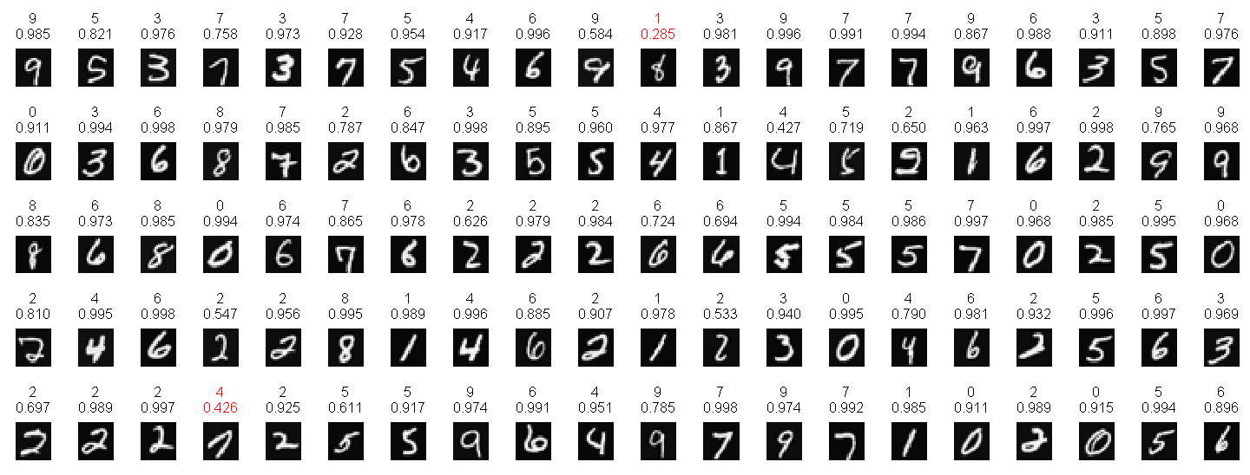
Forward propagation
P33
The learning component is missing.

Slide 3

Cost function
Neural Networks: Learning
Machine Learning

Slide 4
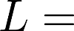
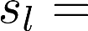
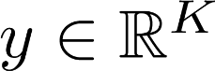
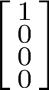
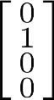
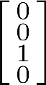
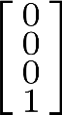
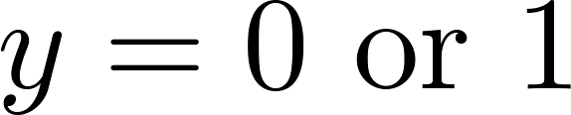
Neural Network (Classification)
total no. of layers in network
no. of units (not counting bias unit) in layer
Layer 1
Layer 2
Layer 3
Layer 4
Binary classification
1 output unit
Multi-class classification (K classes)
K output units
E.g. , , ,
pedestrian car motorcycle truck

Slide 5
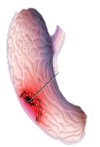
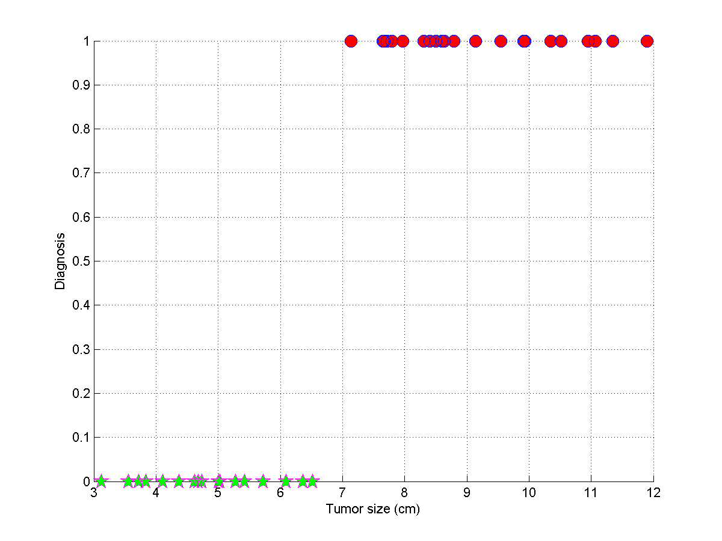
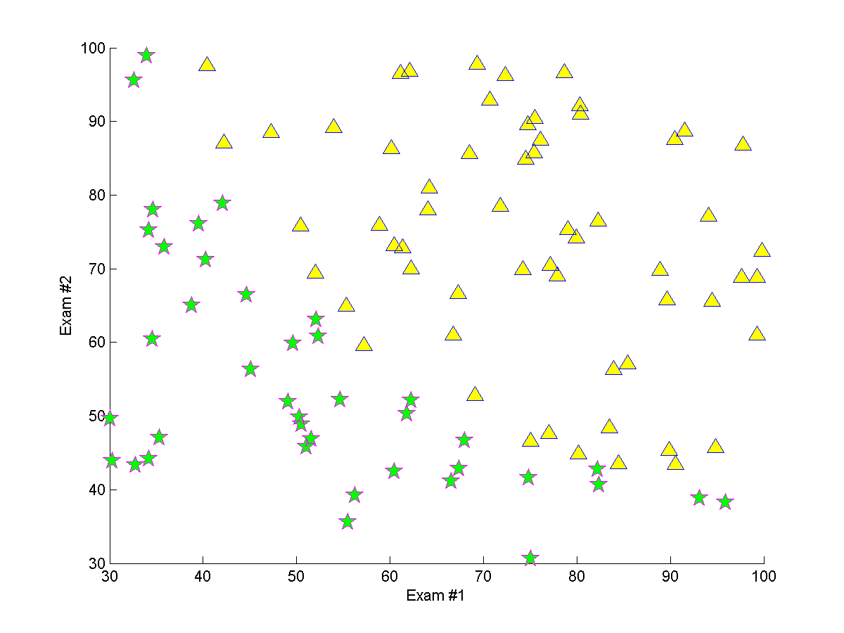
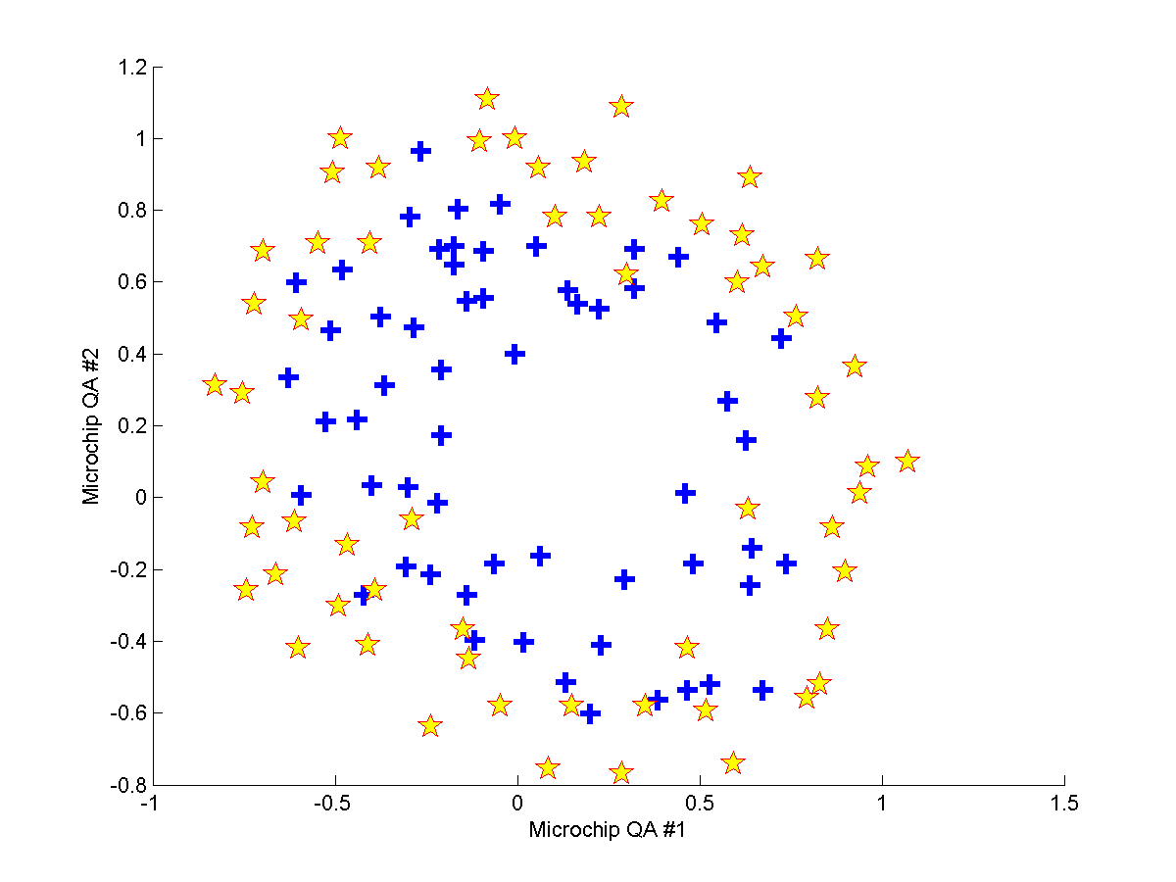


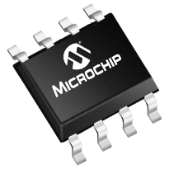

Input layer
Output layer
Input layer
Output layer
Input layer
Output layer

Slide 6
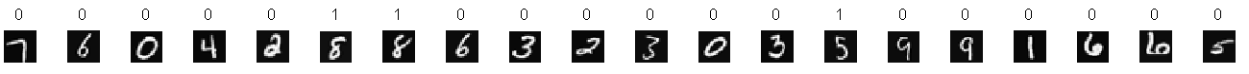
…
401

Slide 7
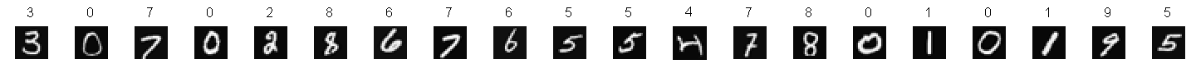
For 0
For 1
For 2
For 3
For 4
…
…
…
…
…
401
401
401
401
401
For 5
For 6
For 7
For 8
For 9
…
…
…
…
…
401
401
401
401
401

Slide 8
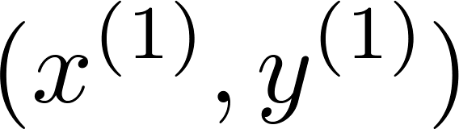
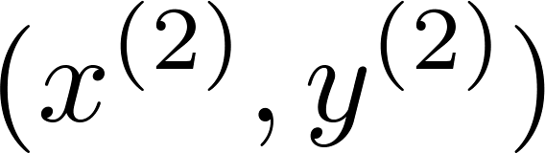
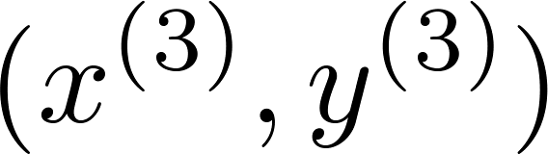
Cost function
Logistic regression:
Tumour size
+
+

Slide 9
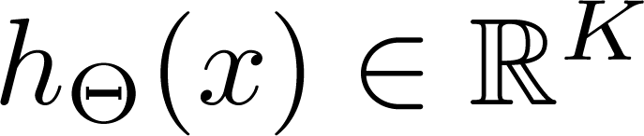
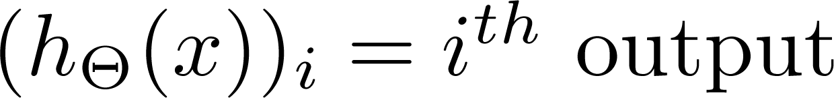
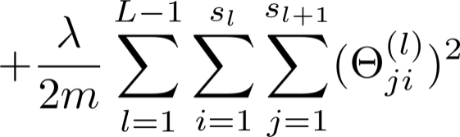
Cost function
Logistic regression:
Neural network:

Slide 10
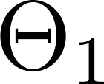
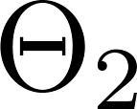
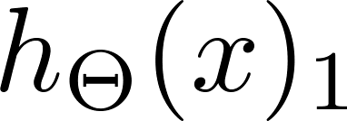
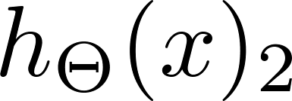
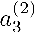
+
+
+
+

Slide 11
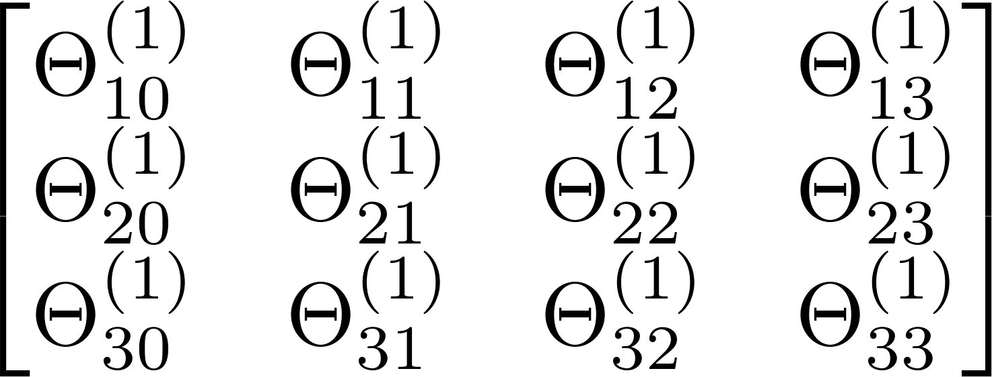
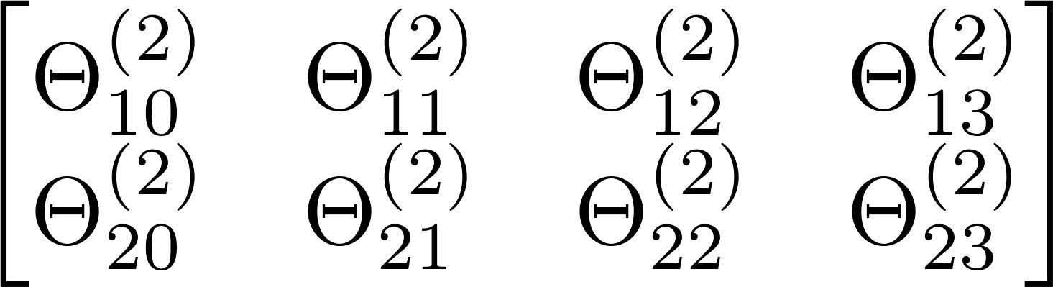
+
+
+
+
+
+
+

Slide 12
P36
Implement the cost function with the pre-trained weights involved in dataChap6

Slide 13
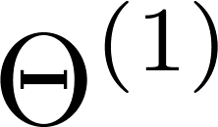
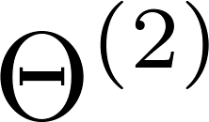
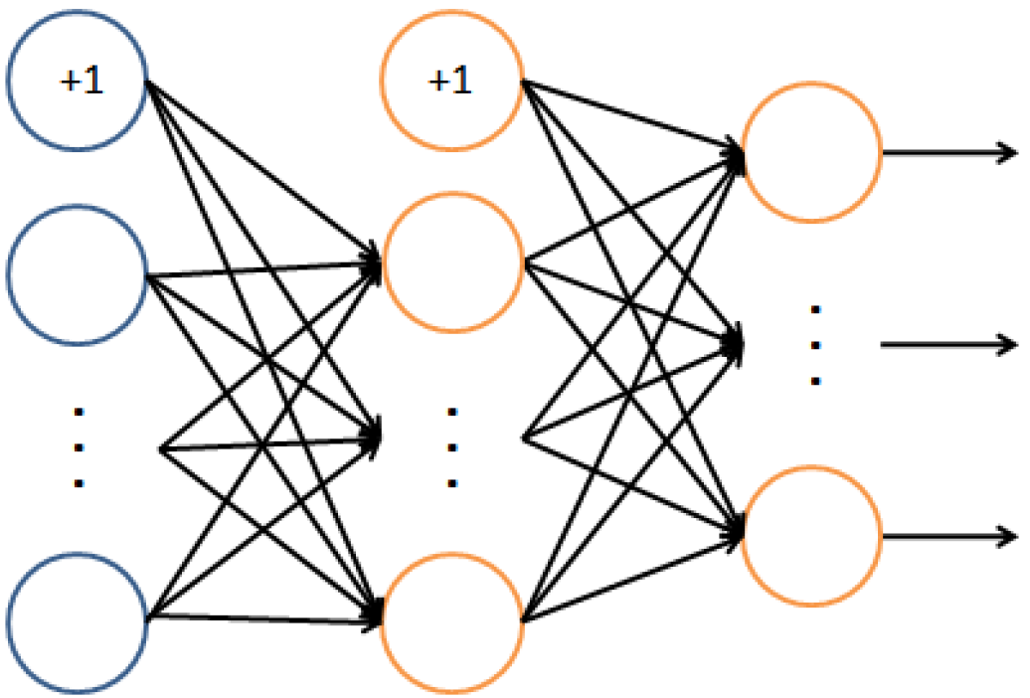
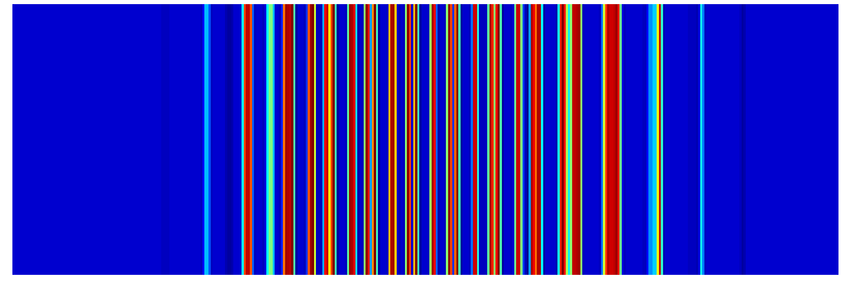
P36
400+1
25+1
10
Input layer
Hidden layer
Output layer

Slide 14
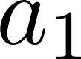
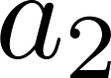
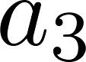
P36
25 * 401
10 * 26
…
401 * 5000
26 * 5000
10 * 5000
400+1
25+1
10
Input layer
Hidden layer
Output layer

Slide 15
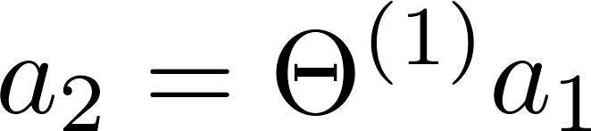
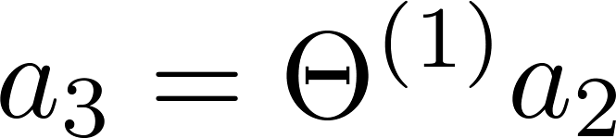
P36
25 * 401
10 * 26
Add bias node
Add bias node
401 * 5000
26 * 5000
10 * 5000
400+1
25+1
10
Input layer
Hidden layer
Output layer

Slide 16


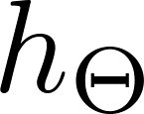
Remapping y:
P36
10 * 5000
5000 * 1
Comprise 1, 2, 3, …, 10
Comprise 1, 0
401 * 5000
26 * 5000
10 * 5000

Slide 17
Remap y:
10 * 5000
P36
0 | 0 | 0 | 0
0 | 1 | 0 | 0
0 | 0 | 0 | 0
0 | 0 | 1 | 0
0 | 0 | 0 | 0
0 | 0 | 0 | 0
0 | 0 | 0 | 0
1 | 0 | 0 | 0
0 | 0 | 0 | 0
0 | 0 | 0 | 1
5000 * 1
Comprise 1, 2, 3, …, 10
…
m = length(y);
numOut = 10;
yNew = zeros(numOut * m, 1);
iOne = (0 : (m - 1)) * numOut + y’
yNew(iOne) = 1;
yNew = reshape(yNew, numOut, []);
50000 * 1
8
2
4
10

Slide 18
0 | 1 | 2 | 3 | 4 | 5 | … | 4998 | 4999
m = length(y);
numOut = 10;
yNew = zeros(numOut * m, 1);
iOne = (0 : (m - 1)) * numOut + y’
yNew(iOne) = 1;
yNew = reshape(yNew, numOut, []);
50000 * 1

Slide 19
0 | 1 | 2 | 3 | 4 | 5 | … | 4998 | 4999
0 | 10 | 20 | 30 | 40 | 50 | … | 49980 | 49990
m = length(y);
numOut = 10;
yNew = zeros(numOut * m, 1);
iOne = (0 : (m - 1)) * numOut + y’
yNew(iOne) = 1;
yNew = reshape(yNew, numOut, []);
50000 * 1

Slide 20
0 | 1 | 2 | 3 | 4 | 5 | … | 4998 | 4999
0 | 10 | 20 | 30 | 40 | 50 | … | 49980 | 49990
6 | 7 | 4 | 2 | 5 | 8 | … | 10 | 1
6 | 17 | 24 | 32 | 45 | 58 | … | 49990 | 49991
m = length(y);
numOut = 10;
yNew = zeros(numOut * m, 1);
iOne = (0 : (m - 1)) * numOut + y’
yNew(iOne) = 1;
yNew = reshape(yNew, numOut, []);
50000 * 1

Slide 21
Implementation note: Unrolling parameters
Neural Networks: Learning
Machine Learning

Slide 22
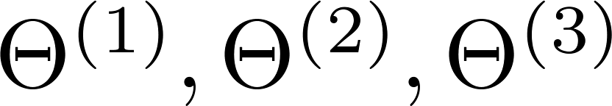
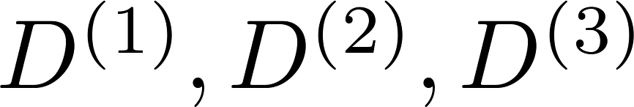
Advanced optimization
function [jVal, gradient] = costFunction(theta)
optTheta = fminunc(@costFunction, initialTheta, options)
…
Neural Network (L=4):
- matrices (Theta1, Theta2, Theta3)
- matrices (D1, D2, D3)
“Unroll” into vectors

Slide 23
unroll
roll

Slide 24
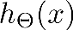
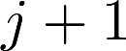
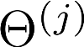
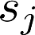
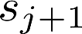
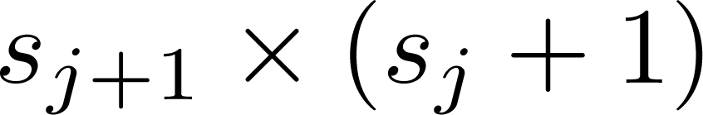
Example
P34
unroll
thetaVec = [ Theta1(:); Theta2(:) ];
DVec = [D1(:); D2(:)];
Theta1 = reshape(thetaVec(1:110),10,11);
Theta2 = reshape(thetaVec(111:220),10,11);
roll
If network has units in layer , units in layer , then
will be of dimension .

Slide 25
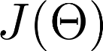
Learning Algorithm
Have initial parameters .
Unroll to get initialTheta to pass to
fminunc(@costFunction, initialTheta, options)
function [jval, gradientVec] = costFunction(thetaVec)
From thetaVec, get .
Use forward prop/back prop to compute and .
Unroll to get gradientVec.

Slide 26
Backpropagation algorithm
Neural Networks: Learning
Machine Learning

Slide 27
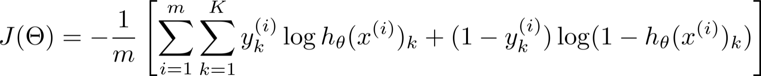
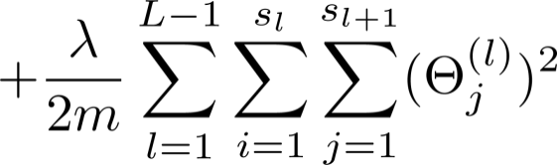



Gradient computation
Need code to compute:

Slide 28










Gradient computation
Given one training example ( , ):
Forward propagation:
Layer 1
Layer 2
Layer 3
Layer 4
function [dec, pro, act] = forwProp3layer(x, Theta1, Theta2)

Slide 29


Slide 30




Gradient computation: Backpropagation algorithm
Intuition: “error” of node in layer .
For each output unit (layer L = 4)
Layer 1
Layer 2
Layer 3
Layer 4

Slide 31

exp(-z)
--------------
2
(exp(-z) + 1)
syms z g
g = 1 / (1 + exp(-z) );
gDiff = diff(g, z);
gDiff = simplify(gDiff);
pretty(gDiff);
P35

Slide 32














Backpropagation algorithm
Training set
Set (for all ).
For
Set
Perform forward propagation to compute for
Using , compute
Compute
P37

Slide 33
Backpropagation algorithm
Training set
Set (for all ).
For
Set
Perform forward propagation to compute for
Using , compute
Compute
[~, ~, act]= forwProp3Layer(X, Theta1, Theta2);
delta3 = act.a3 - yNew;
gDiff2 = exp(-act.z2) ./ (exp(-act.z2) + 1).^2;
delta2 = T2' * delta3 .* gDiff2;

Slide 34
Backpropagation algorithm
Training set
Set (for all ).
For
Set
Perform forward propagation to compute for
Using , compute
Compute
[~, ~, act]= forwProp3Layer(X, Theta1, Theta2);
Delta2 = delta3 * act.a2';
Delta1 = delta2 * act.a1';
T1 = [zeros(size(Theta1,1),1), Theta1(:,2:end)];
T2 = [zeros(size(Theta2,1),1), Theta2(:,2:end)];
gradTheta1 = 1 / m * Delta1 + lambda / m * T1;
gradTheta2 = 1 / m * Delta2 + lambda / m * T2;

Slide 35
Backpropagation algorithm
BP neural network

Slide 36
Unrolled Theta
P34
P35
P38
P36
P37
cost3LayerNN
Unrolled Gradient
Cost

Slide 37
Backpropagation intuition
Neural Networks: Learning
Machine Learning

Slide 38



Forward Propagation

Slide 39
Forward Propagation

Slide 40



What is backpropagation doing?
Focusing on a single example , , the case of 1 output unit, and ignoring regularization ( ),
(Think of )
I.e. how well is the network doing on example i?

Slide 41









Forward Propagation
“error” of cost for (unit in layer ).
Formally, (for ), where

Slide 42
Gradient checking
Neural Networks: Learning
Machine Learning

Slide 43

Numerical estimation of gradients
Implement: gradApprox = (J(theta + EPSILON) – J(theta – EPSILON)) /(2*EPSILON)

Slide 44



Parameter vector
(E.g. is “unrolled” version of )

Slide 45
for i = 1:n,
thetaPlus = theta;
thetaPlus(i) = thetaPlus(i) + EPSILON;
thetaMinus = theta;
thetaMinus(i) = thetaMinus(i) – EPSILON;
gradApprox(i) = (J(thetaPlus) – J(thetaMinus))
/(2*EPSILON);
end;
Check that gradApprox ≈ DVec

Slide 46
function numGrad = compNumGrad(J, theta)
numGrad = zeros(size(theta));
n = length(theta);
e = 1e-4;
for i = 1 : n
% Set perturbation vector
tPlus = theta;
tMinus = theta;
tMinus(i) = tMinus(i) - e;
tPlus(i) = tPlus(i) + e;
jMinus = J(tMinus);
jPlus = J(tPlus);
% Compute Numerical Gradient
numGrad(i) = (jPlus - jMinus) / ( 2*e );
end
P38

Slide 47
Implementation Note:
Implement backprop to compute DVec (unrolled ).
Implement numerical gradient check to compute gradApprox.
Make sure they give similar values.
Turn off gradient checking. Using backprop code for learning.
Important:
Be sure to disable your gradient checking code before training your classifier. If you run numerical gradient computation on every iteration of gradient descent (or in the inner loop of costFunction(…))your code will be very slow.

Slide 48
P39
Check the validity of computeCostLog based on exam data.
1.0e-03 *
0.0718
0.3363
0.0337
1.0e-03 *
0.0718
0.3423
0.0380

Slide 49
Random initialization
Neural Networks: Learning
Machine Learning

Slide 50

Initial value of
For gradient descent and advanced optimization method, need initial value for .
optTheta = fminunc(@costFunction, initialTheta, options)
Consider gradient descent
Set ?
initialTheta = zeros(n,1)

Slide 51




Zero initialization
After each update, parameters corresponding to inputs going into each of two hidden units are identical.

Slide 52
Rand
Uniformly distributed pseudorandom numbers
Generate values from the uniform distribution on the interval [a,b]:
Randn
Normally distributed pseudorandom numbers
Generate values from a normal distribution with mean 1 and standard deviation 2:
r = a + (b-a) .* rand(100,1);
r = 1 + 2 .* randn(100,1);

Slide 53


Rand
Randn

Slide 54



Random initialization: Symmetry breaking
Initialize each to a random value in
(i.e. )
E.g.
Theta1 = rand(10,11)*(2*INIT_EPSILON)
- INIT_EPSILON;
Theta2 = rand(1,11)*(2*INIT_EPSILON) - INIT_EPSILON;

Slide 55

P40

Slide 56
Putting it together
Neural Networks: Learning
Machine Learning

Slide 57
Training a neural network
Pick a network architecture (connectivity pattern between neurons)
No. of input units: Dimension of features
No. output units: Number of classes
Reasonable default: 1 hidden layer, or if >1 hidden layer, have same no. of hidden units in every layer (usually the more the better)

Slide 58






Training a neural network
Randomly initialize weights
Implement forward propagation to get for any
Implement code to compute cost function
Implement backprop to compute partial derivatives
for i = 1:m
Perform forward propagation and backpropagation using example
(Get activations and delta terms for ).
cost3LayerNN is well vectorized.

Slide 59

Training a neural network
Use gradient checking to compare computed using backpropagation vs. using numerical estimate of gradient of . Then disable gradient checking code.
Use gradient descent or advanced optimization method with backpropagation to try to minimize as a function of parameters

Slide 60




Slide 61
Recognize
handwritten
digits
P41
It is a subset of the MNIST handwritten digit dataset (http://yann.lecun.com/exdb/mnist/)
Yann LeCun,
Courant Institute, NYU
Corinna Cortes,
Google Labs, New York
Christopher J.C. Burges,
Microsoft Research, Redmond

Slide 62


LeCun, Y., Boser, B., Denker, J. S., Henderson, D., Howard, R. E., Hubbard, W., & Jackel, L. D. (1989). Backpropagation applied to handwritten zip code recognition. Neural computation, 1(4), 541-551.

Slide 63

Yann LeCun was born near Paris, France, in 1960. He received a Diplôme d'Ingénieur from the Ecole Superieure d'Ingénieur en Electrotechnique et Electronique, Paris in 1983, and a PhD in Computer Science from Université Pierre et Marie Curie in 1987 during which he proposed an early form of the back-propagation learning algorithm for neural networks. He was a postdoctoral research associate in Geoffrey Hinton's lab at the University of Toronto.
Y. LeCun: Une procédure d'apprentissage pour réseau a seuil asymmetrique (a Learning Scheme for Asymmetric Threshold Networks), Proceedings of Cognitiva 85, 599–604, Paris, France, 1985.

Slide 64

In 1988, he joined the Adaptive Systems Research Department at AT&T Bell Laboratories in Holmdel, New Jersey, USA, where he developed a number of new machine learning methods, such as a biologically inspired model of image recognition called Convolutional Neural Networks, the "Optimal Brain Damage" regularization methods, and the Graph Transformer Networks method (similar to conditional random field), which he applied to handwriting recognition and OCR. The bank check recognition system that he helped develop was widely deployed by NCR and other companies, reading over 10% of all the checks in the US in the late 1990s and early 2000s.

Slide 65

In 1996, he joined AT&T Labs-Research as head of the Image Processing Research Department, which was part of Lawrence Rabiner's Speech and Image Processing Research Lab, and worked primarily on the DjVu image compression technology, used by many websites, notably the Internet Archive, to distribute scanned documents. His collaborators at AT&T include Léon Bottou and Vladimir Vapnik.

Slide 66


After a brief tenure as a Fellow of the NEC Research Institute (now NEC-Labs America) in Princeton, NJ, he joined New York University (NYU) in 2003

Slide 67


On December 9, 2013, LeCun became the head of Facebook's new Artificial Intelligence laboratory in New York City.

Slide 68


Without regularization
sizeHid=50
Elapsed time is 9.709350 seconds.
Train Accuracy (based on training data): 96.37%
Train Accuracy (based on test data): 91.00%
94.29%
91.00%
93.39%
90.00%
99.82%
97.00%
rng(666)
95.00%
Elapsed time is 8.974104 seconds.
Train Accuracy (based on training data): 96.63%
Train Accuracy (based on test data): 88.00%
94.27%
90.00%
93.59%
90.00%
rng(531)
95.00%
93.00%
rng(742)
Elapsed time is 8.843744 seconds.
Train Accuracy (based on training data): 96.43%
Train Accuracy (based on test data): 86.00%
94.51%
90.00%
93.67%
90.00%
95.00%
95.00%
Elapsed time is 10.552962 seconds.
Train Accuracy (based on training data): 96.47%
Train Accuracy (based on test data): 89.00%
94.37%
92.00%
93.53%
93.00%
rng(38)
95.00%
95.00%

Slide 69
Backpropagation example: Autonomous driving (optional)
Neural Networks: Learning
Machine Learning

Slide 70

[Courtesy of Dean Pomerleau]

Slide 71
3 Layers
Arbitrary number of Layers
P42

Slide 72




Forward propagation
Add .

Slide 73
Backward propagation
Training set
Set (for all ).
For
Set
Perform forward propagation to compute for
Using , compute
Compute

Slide 74

Matrix
Cell
thetaCell
aCell
zCell
gradCell
deltaCell

Slide 75
structNN = [400, 25, 10];
function [decTest, proTest] = neuralNetwork(structNN, lambda, xTrain, yTrain, xTest, yTest, xCV, yCV)
function [dec, pro, aCell, zCell]=forwPropNN(x, tCell, structNN)
function [cost, grad] = costNN(thetaVec, structNN, X, y,lambda)
function thetaCell = rollTheta(thetaVec, structNN)

Slide 76
function thetaCell = rollTheta(thetaVec, structNN)
numLayer = length(structNN);
thetaCell = cell( numLayer-1, 1 );
nodNextLayer = structNN(2 : end);
nodPrevLayer = structNN(1 : end-1) + 1;
numNode = nodNextLayer .* nodPrevLayer;
iStart = 1;
iEnd = numNode(1);
for i = 1 : numLayer - 1
thetaCell{i} = reshape(thetaVec(iStart : iEnd ),...
nodNextLayer(i), nodPrevLayer(i));
if i < numLayer - 1
iStart = iEnd + 1;
iEnd = iStart + numNode(i + 1) - 1;
end
end

Slide 77
Connect neural network to logistic regression

Slide 78


P27
P43

Slide 79


Slide 80
P29
Classify the specified digit with BPNN.
P44

